Slide 1
Harmony
of society
Presenter: 胡博浩，姜鑫，黄飞越，柯友彬

Slide 2
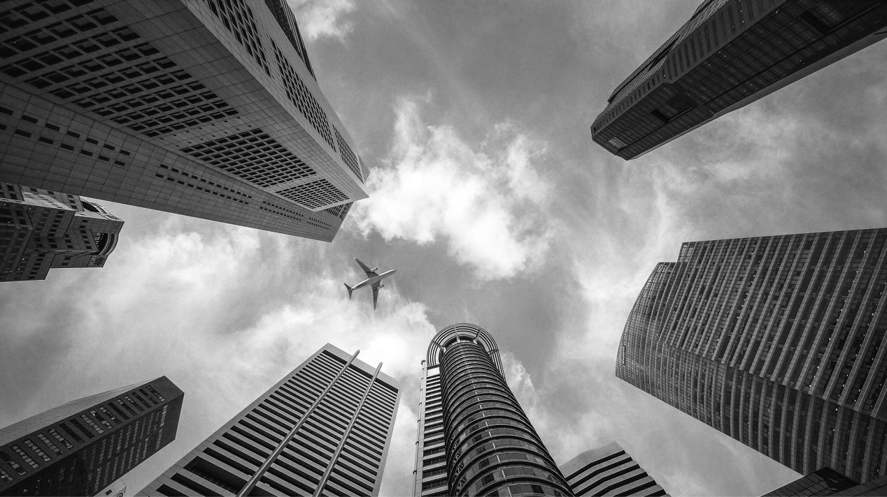
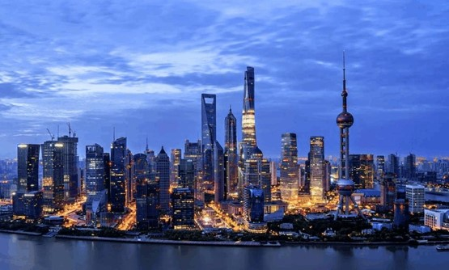
CONTENTS
Importance of harmony
Harmony in China
Global harmony
What should we do

Slide 3
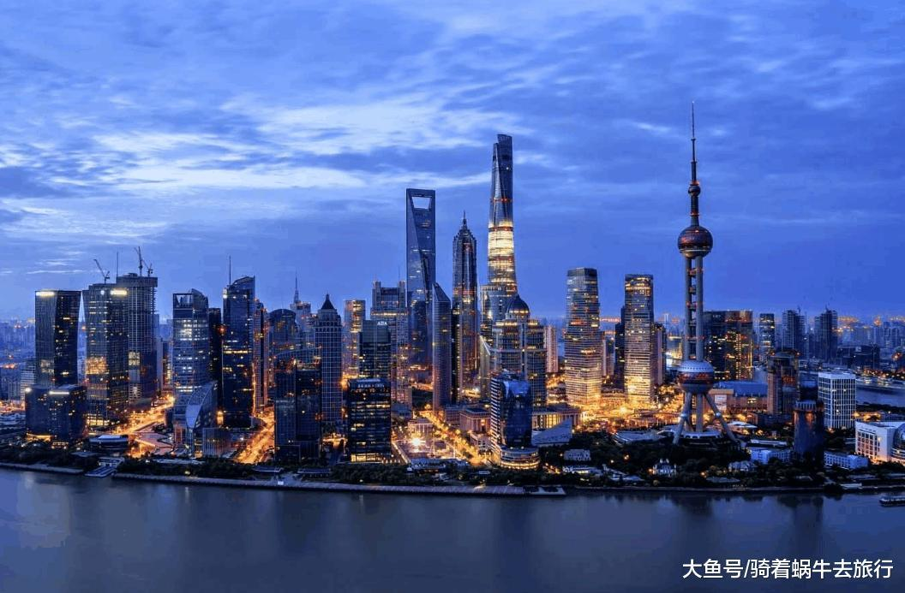
PART 01
What is social harmony and why is it so important.

Slide 4
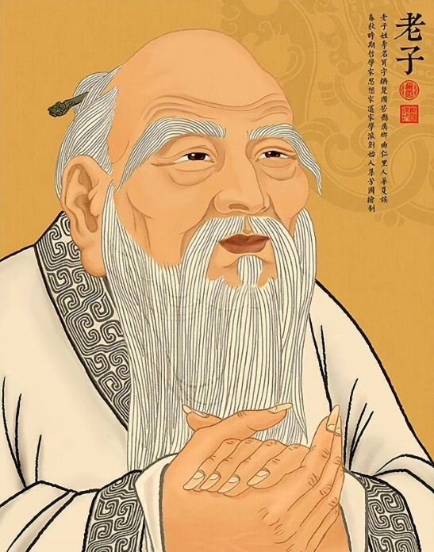
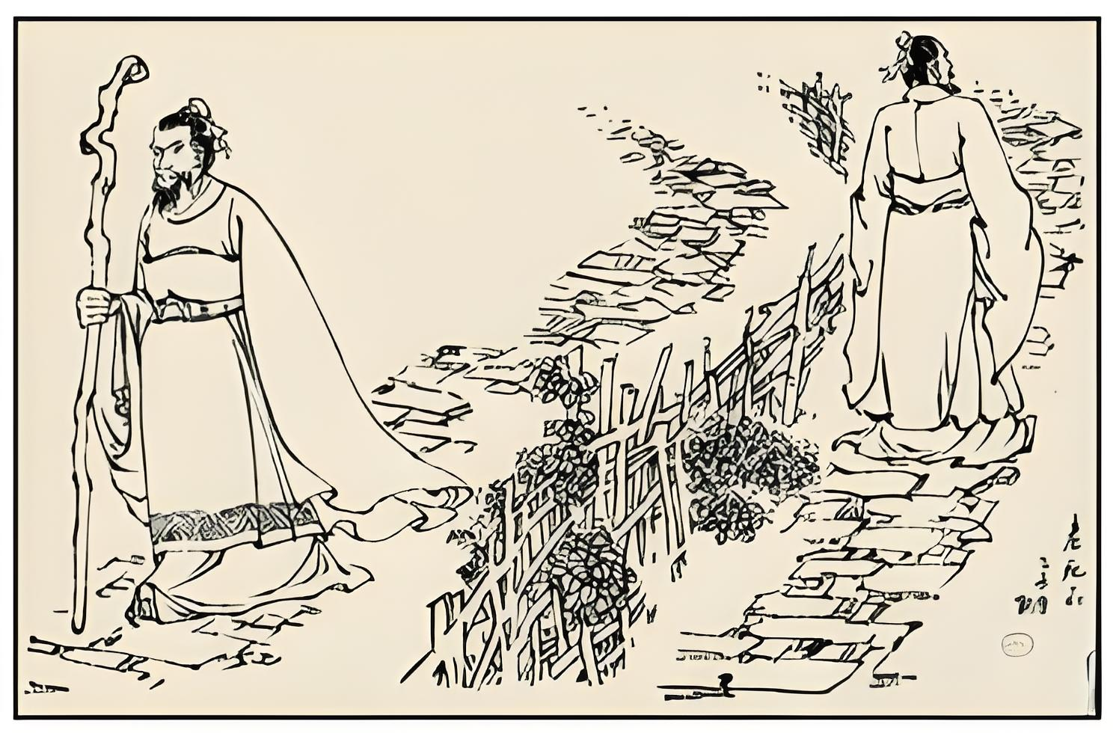
Lao Zi
Sparse Population in a Small Country（小国寡民）
The people eat sweetly, dress beautifully, live comfortably, and live happily.
Countries can see each other and hear the cries of chickens and dogs.
but people do not interact with each other from birth to death.

Slide 5


Game
Cyber Punk
In the world of cyber punk, technology has become highly advanced, and robots and artificial intelligence can meet people's needs. However, there are no legal constraints , and people generally lack good education.

Slide 6

FILM
THT WANFERING EARTH
In the movie "Wandering Earth," technology is highly advanced but the Earth's environment is extremely bad. People from all over the world unite closely, work hard, and hope to save their homes

Slide 7



Harmony
People from all over the world can unite, love, and help each other
Social security is stable, and people receive good education
In society, technology is advanced, the environment is livable, and people's various needs are met

Slide 8
The social harmony in China
Part 02

Slide 9
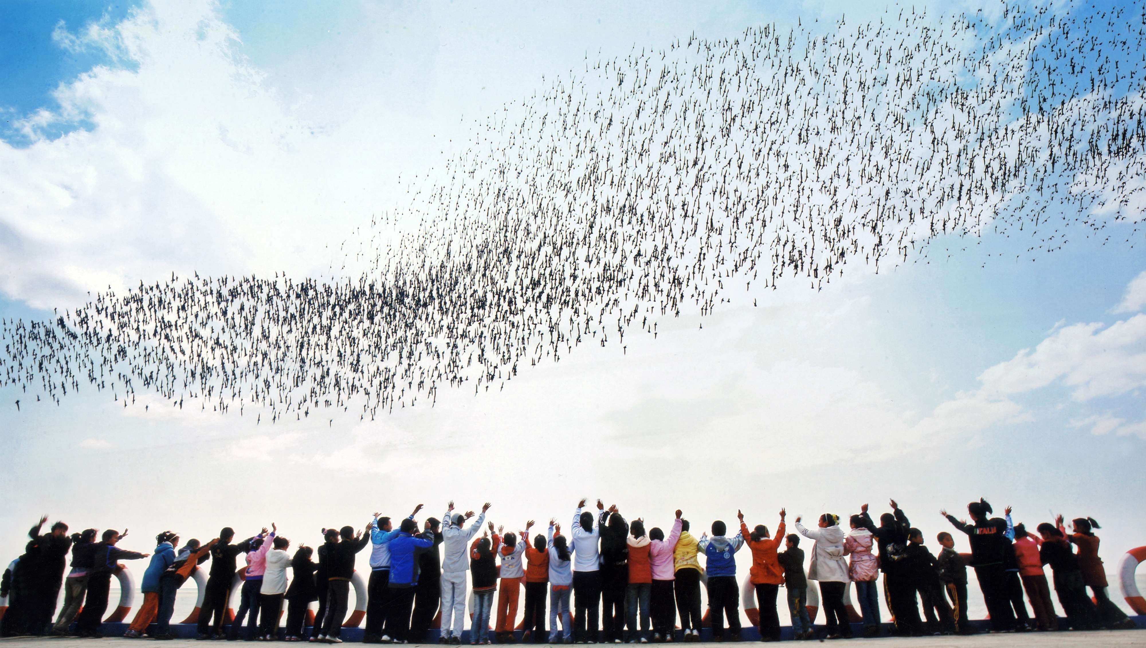
Improvement in Social Governance
Implementation of policies and measures ○
Establishment of a sound legal system ○
Enhancing grassroots governance ○
and community construction ○
Economic Development and
Poverty Alleviation
According to official data, China has achieved comprehensive poverty eradication by 2020, marking a historic milestone that significantly improved the living standards of millions of people.
Economic Development and Poverty Alleviation
Improvement in living standards ○
Strengthening social stability and cohesion ○
Addressing imbalanced urban-rural development○
… … ○

Slide 10
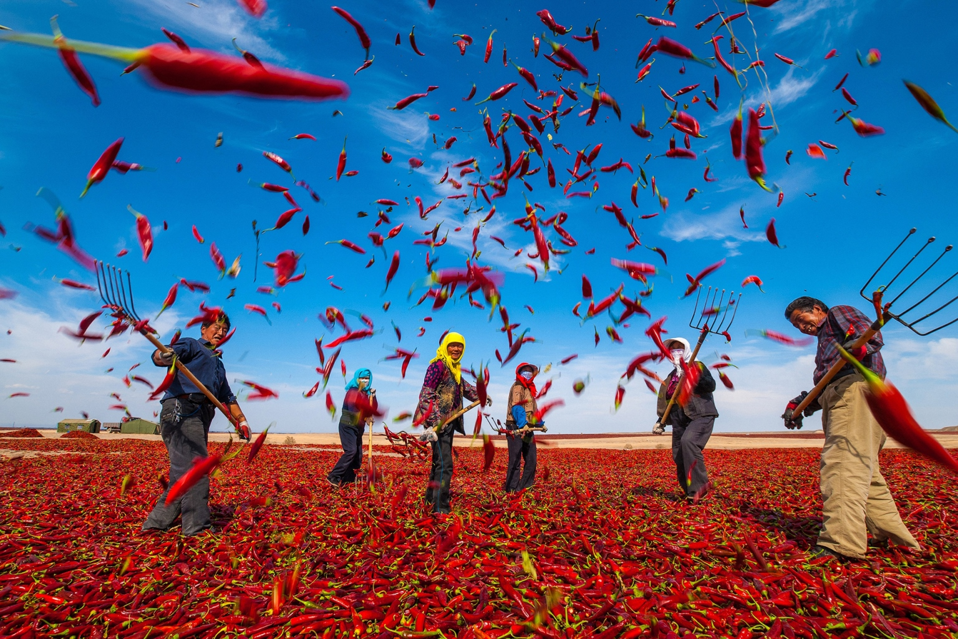
Improvement in Social Governance
Implementation of policies and measures ○
Establishment of a sound legal system ○
Enhancing grassroots governance ○
and community construction ○
Economic Development and
Poverty Alleviation
According to official data, China has achieved comprehensive poverty eradication by 2020, marking a historic milestone that significantly improved the living standards of millions of people.
Economic Development and Poverty Alleviation
Improvement in living standards ○
Strengthening social stability and cohesion ○
Addressing imbalanced urban-rural development○
… … ○

Slide 11

Improvement in Social Governance
Implementation of policies and measures ○
Establishment of a sound legal system ○
Enhancing grassroots governance ○
and community construction ○
Economic Development and
Poverty Alleviation
According to official data, China has achieved comprehensive poverty eradication by 2020, marking a historic milestone that significantly improved the living standards of millions of people.
Economic Development and Poverty Alleviation
Improvement in living standards ○
Strengthening social stability and cohesion ○
Addressing imbalanced urban-rural development○
… … ○

Slide 12
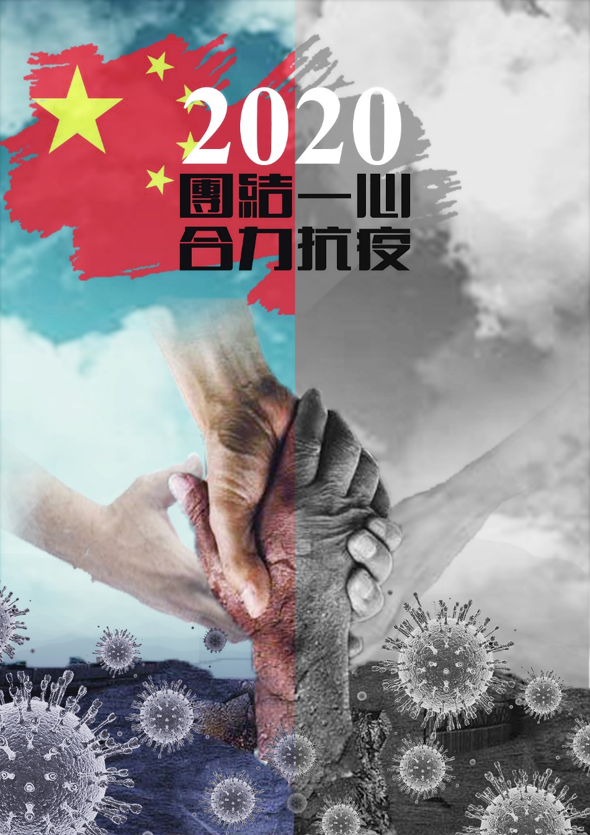
Effective response to sudden events
during the outbreak of the pandemic, the Chinese government promptly introduced a series of prevention and control measures and effectively controlled the spread of the virus through strong organizational coordination and social mobilization, maintaining social stability and security.

Slide 13
Cultural Inheritance & Pluralistic Integration
Promotion of cultural innovation and development
Advocacy for cultural diversity and inclusiveness
Establishment of a sound legal system
Protection and development of ethnic minority cultures
Promotion of exchanges and integration among various cultures

Slide 14

Influence of Traditional Chinese Culture
Emphasis on harmony and unity
Core values in Confucianism (e.g., benevolence, harmony)

Slide 15

Government's Emphasis on Social Harmony
Long-standing emphasis and investment
Formulation and implementation of policies
Promotion of social fairness and justice
Provision of opportunities and equal development environment

Slide 16
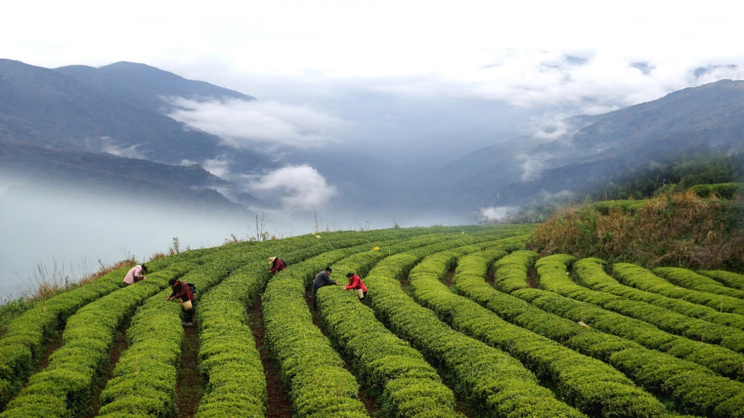
Impact of Reform and Opening-up Policy
Promotion of diversification and openness
Absorption and learning from foreign cultures and experiences
Injection of vitality and impetus into social harmony

Slide 17
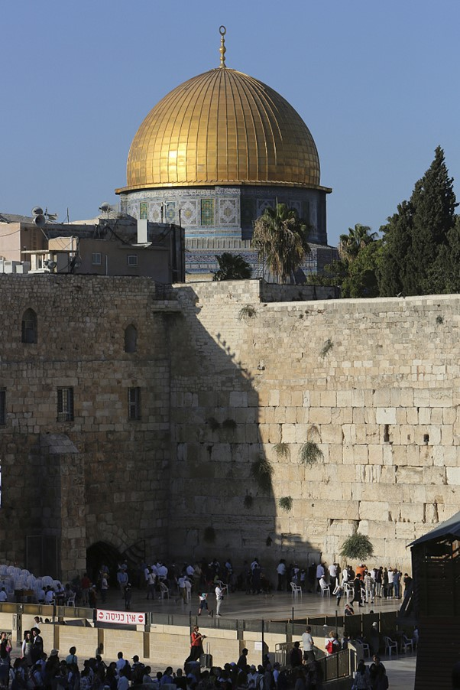
Part 03
Harmony
in the international community

Slide 18
The importance
The global impact
the safety of local populations○
political stability ○
ethnic relations ○
Economy ○
… … ○
cultural exchange
global stability &prosperity
economic cooperation
transnational challenges
the risk of war and conflict

Slide 19
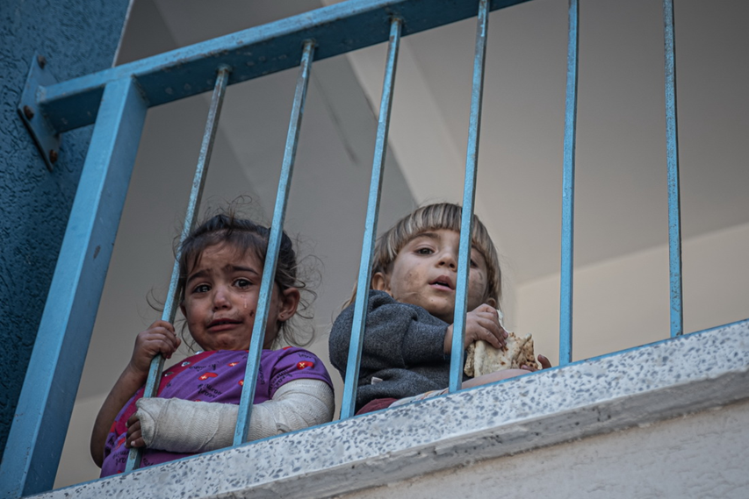
The global impact
the safety of local populations○
political stability ○
ethnic relations ○
Economy ○
… … ○
The importance
cultural exchange
global stability &prosperity
economic cooperation
transnational challenges
the risk of war and conflict

Slide 20
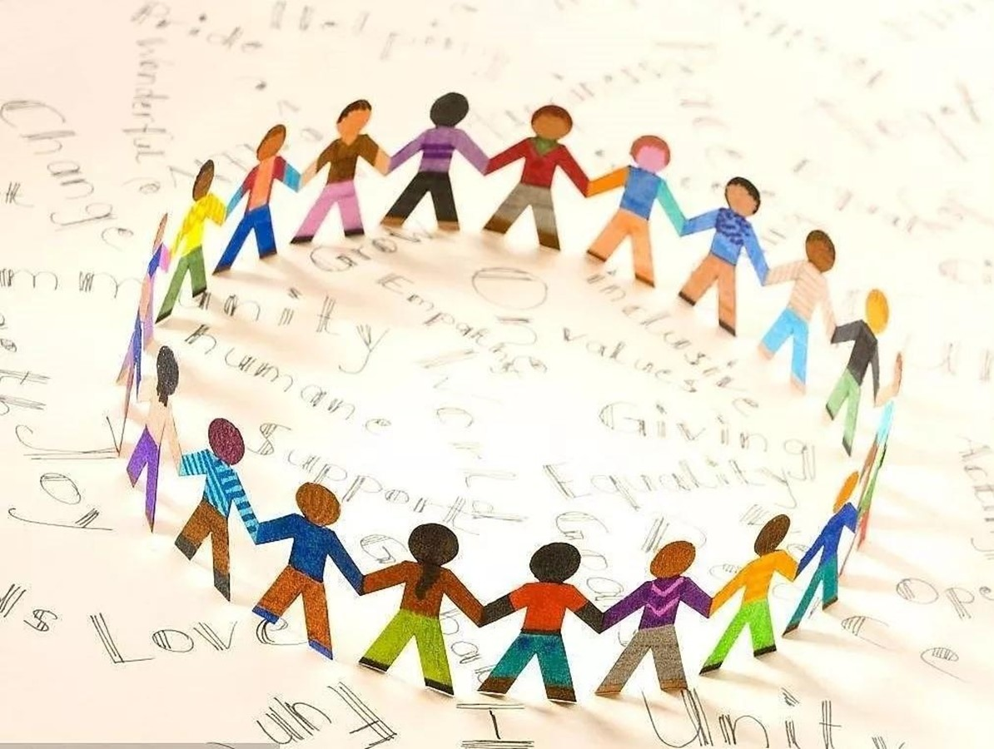
Efforts and prospects
By actively participating in international cooperation and cultural exchanges, we can contribute to building a more harmonious, prosperous and respectful global society.
Actions and contributions
A comprehensive ceasefire and cessation of hostilities.
Earnestly protect civilians.
Ensuring humanitarian assistance.
increase diplomatic mediation.
seek a political solution.
harmony in diversity
In today's world, the future and destiny of all countries are closely linked, and only by sharing and learning from each other on an equal footing on the basis of respecting different countries and civilizations can we achieve common development and mutual benefit.

Slide 21

Efforts and prospects
By actively participating in international cooperation and cultural exchanges, we can contribute to building a more harmonious, prosperous and respectful global society.
Actions and contributions
A comprehensive ceasefire and cessation of hostilities.
Earnestly protect civilians.
Ensuring humanitarian assistance.
increase diplomatic mediation.
seek a political solution.
harmony in diversity
In today's world, the future and destiny of all countries are closely linked, and only by sharing and learning from each other on an equal footing on the basis of respecting different countries and civilizations can we achieve common development and mutual benefit.

Slide 22

Efforts and prospects
By actively participating in international cooperation and cultural exchanges, we can contribute to building a more harmonious, prosperous and respectful global society.
Actions and contributions
A comprehensive ceasefire and cessation of hostilities.
Earnestly protect civilians.
Ensuring humanitarian assistance.
increase diplomatic mediation.
seek a political solution.
harmony in diversity
In today's world, the future and destiny of all countries are closely linked, and only by sharing and learning from each other on an equal footing on the basis of respecting different countries and civilizations can we achieve common development and mutual benefit.

Slide 23

Part 04.
Personal Responsibility: Role and Responsibility in Social Harmony
Future outlook: expectations and hopes for future social harmony
Summary and Appeal: Jointly Building a Better Society

Slide 24
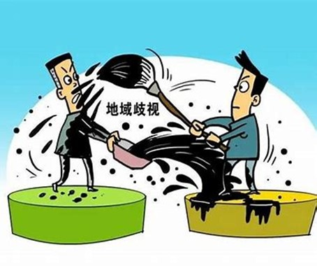

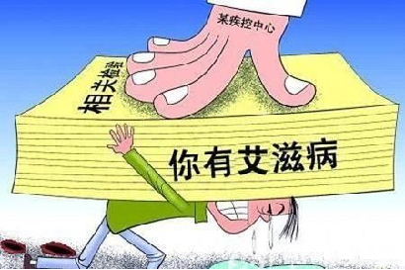
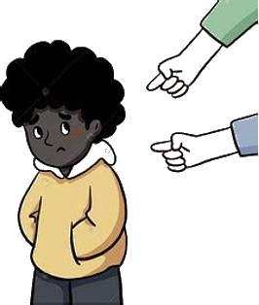
Respect others
Regional discrimination
Discrimination against persons with disabilities
Racial
discrimination
Discrimination against special diseases

Slide 25
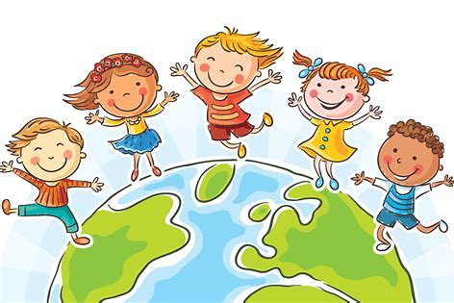
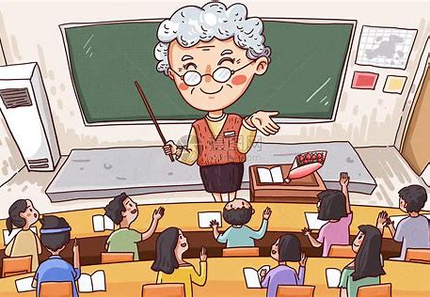

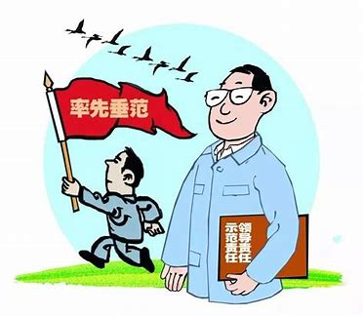
Future outlook
strengthen education
Cultivate students' sense of social responsibility
Increase investment from government and enterprises
Environmental protection and social welfare undertakings
A better
future
Lead by example(以身作则)
Actively fulfilling personal responsibilities

Slide 26
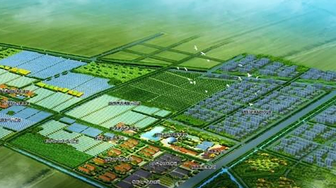
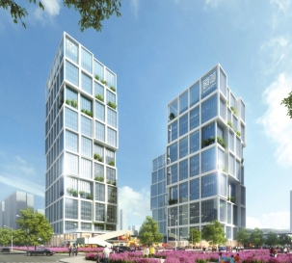
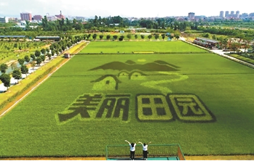
Summary and Appeal
Working together towards a better future!
Ourselves
domestic
abroad
Harmony
of society

Slide 27
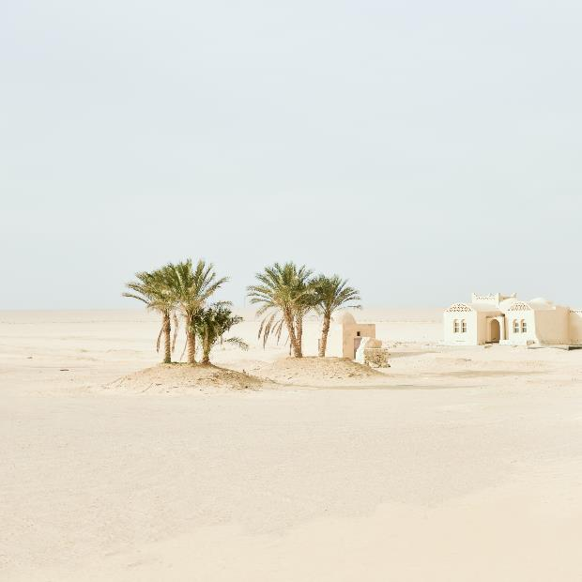
THANKS.
For you listening

